Slide 1
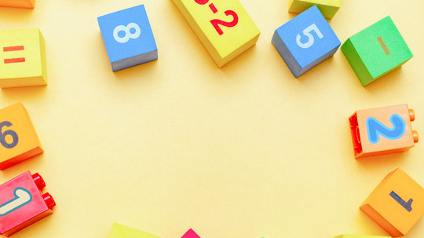
Numeracy Parent Workshops
Blackness Primary School
11th May, 2026
14th May, 2026
Amy Finlay
Alastair Tarbett

Slide 2
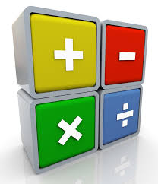
Purpose of the session
At the end of this session:
We will understand the expectations for the end of early, first and second level in numeracy
We will understand the strategies and supports we use to develop numeracy skills in addition, subtraction, multiplication and division
Language and strategies used will be consistent across school and home.

Slide 3
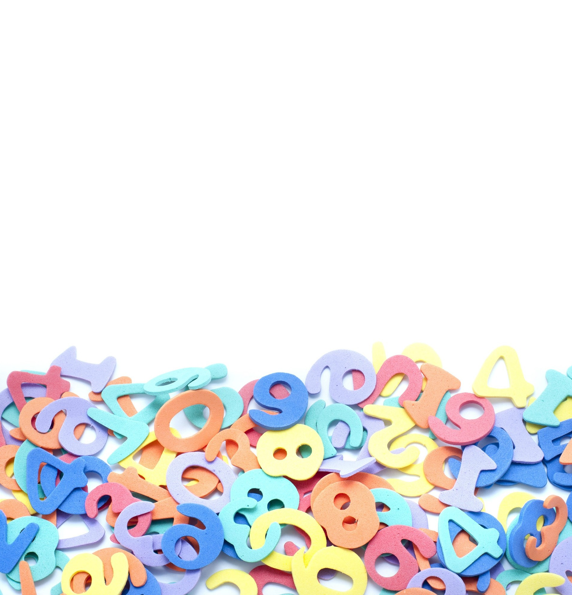
Early Level (Nursery- End of P1)
Exploring numbers and number processes through play- kinaesthetic
Concrete- Pictorial- Abstract
Number- Understanding of the number system to 30, Count forwards and backwards to 30, recognise numerals and quantities (subitising), odd and even numbers
Addition and Subtraction (to 20)- simple addition and subtraction using concrete materials (cubes/numicon/ loose parts)
Multiplication( to 20)- skip counting- beginning to skip count in 2s, 5’s and 10s
Division (to 20)- sharing equally (concrete materials)

Slide 4

First Level (P2- end of P4)
Number- understanding to 100 (p2/p3) and to 1000 (p4), place value, hurdle numbers, count forwards and back, skip count in 2,3,4,5s and 10s
Addition & Subtraction-
p2- number bonds to 20/ two digit+/- 1 digit,
p3- +/- involving 2-digit numbers,
p4- +/- involving 3-digit numbers
Multiplication/ Division-
Multiplication- 2,3,4,5 and 10 (and beyond)
Multiplication by 10 and 100- using understanding of place value to move numbers
Division- dividing by 2,3,4,5 and 10 (and beyond)- beginning to add a remainder

Slide 5

Second Level (P5- End of P7)
Addition and Subtraction
p5 - +/- involving up to 4-digit numbers
p6 - +/- within 10,000
P7 - +/- within 1,000,000 (multiples of 10, 100 and 1000)
Multiplication and Division
P5 – exploring 6,7,8,9 times table
multiply and divide 3-digit numbers by 10 and 100
2 by 1 digit multiplication
Dividing 3-digit numbers with remainders
P6 – regularly apply table facts for 6,7,8,9 times table
Multiply and divide 4-digit numbers by multiples of 10, 100 and 1000
2 by 2-digit multiplication
Multiply and divide 3-digit multiple of 10 by a single digit (e.g. 350 divided by 5)
P7 – regularly apply all table facts from 1-10
Multiply whole numbers by 2-digits
Multiply and divide whole numbers by 10,100 and 1000
Multiply and divide 4-digit multiples of 10 by a single digit (e.g. 1350 by 5)

Slide 6

Second Level - Decimals
P5 – working with 1 place decimals (tenths)
P6 – working with 2 place decimals (hundredths)
P7 – working with 3 place decimals (thousandths)

Slide 7
Numbers we work with…
P1- 20
P2-100
P3/4 1000
P5-10,000
P6- 100,000
P7- 1,000,000

Slide 8
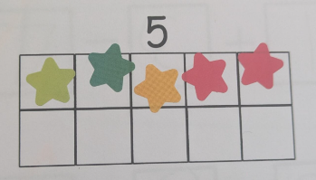
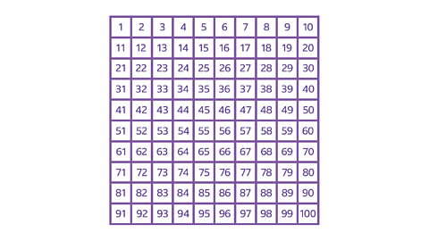
Visual Aids
Visual representations allow understanding of quantity
Ten Frames
Numicon
Number lines- empty and filled
Hundred Square
Drawings

Slide 9
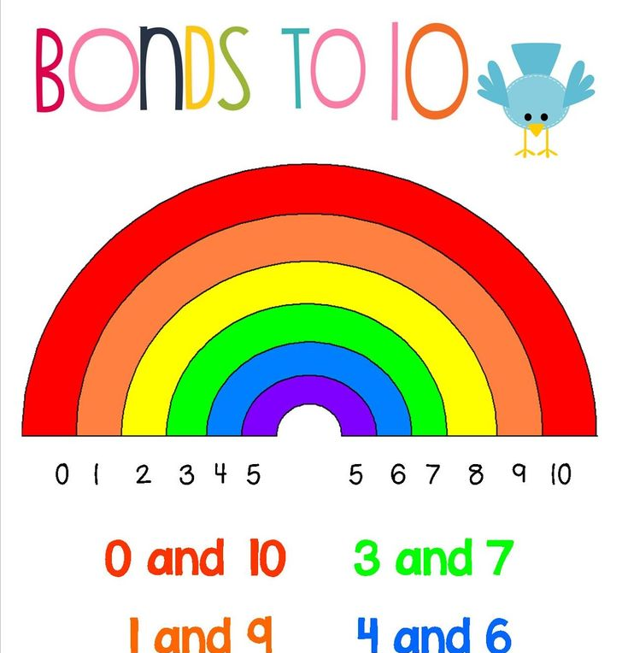
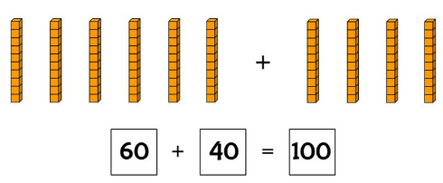
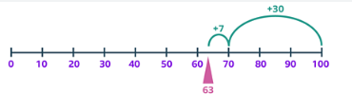
Number Bonds
Pairs of numbers that add up to a specific total
Conceptual understanding of this first with concrete materials (numicon, Cuisenaire rods)
Commutative law- in addition and multiplication, children need to understand that 0+3 is the same as 3+0
Quick recall- once they know them, they can use them to split numbers and recognise number bonds when working with bigger numbers e.g. I know 6+4= 10 so 60+40= 100
63 + 37

Slide 10
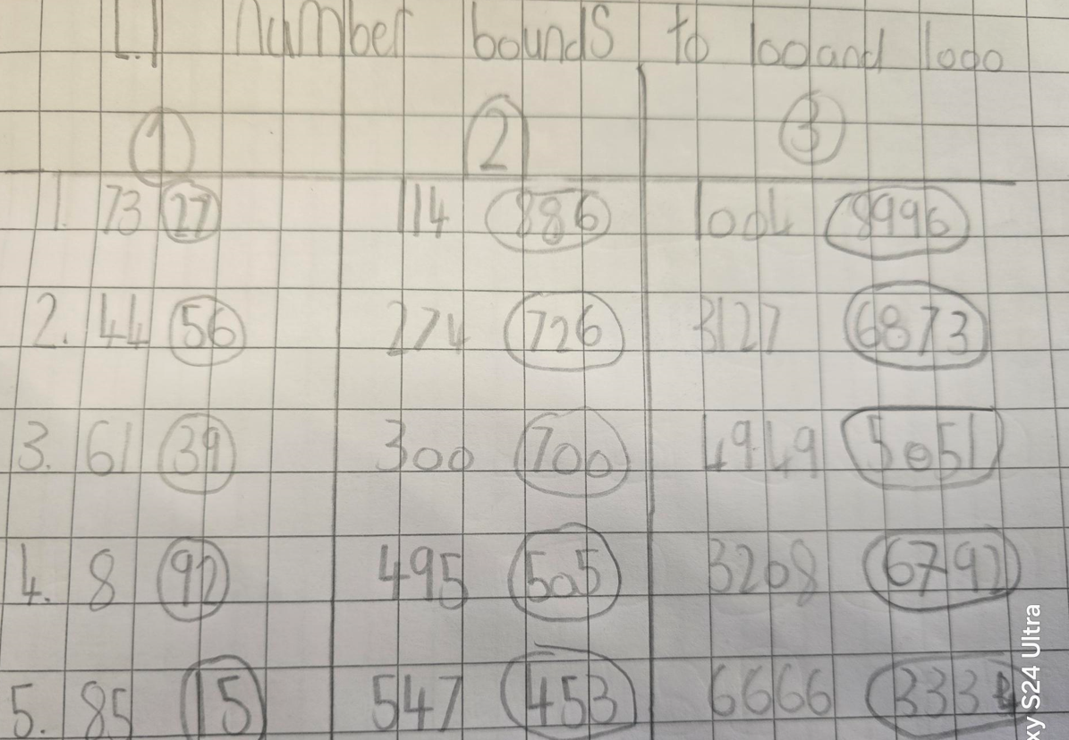
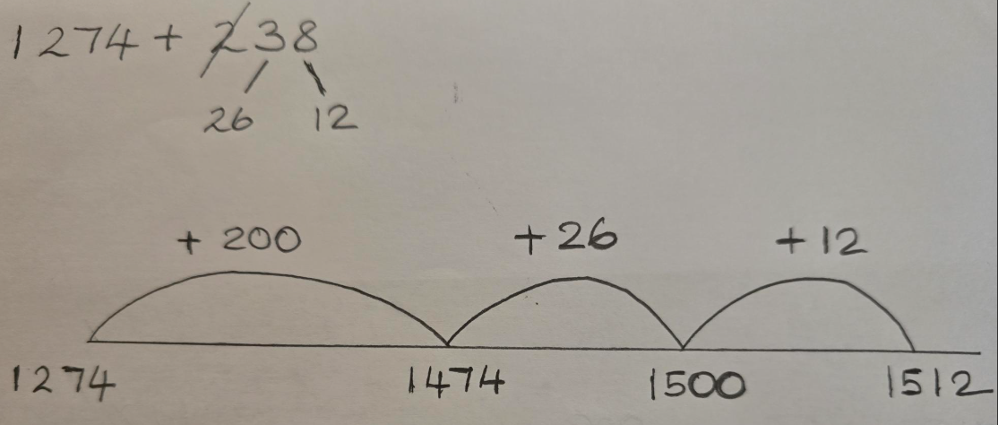
Number Bonds- Moving up the School
The tricky part of this problem is to bridge 1500. When a pupil understands how to apply number bonds, they can quickly see that 74 and 26 make 100. The 38 has been split into 26 and 12 and we will refer to this strategy later.
Number bonds practise. Pupils make the next 10, then make the next 100 and combine.

Slide 11
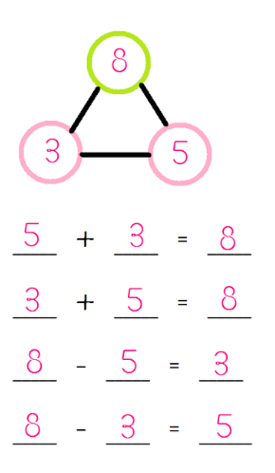
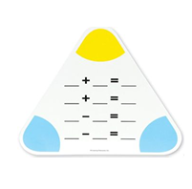
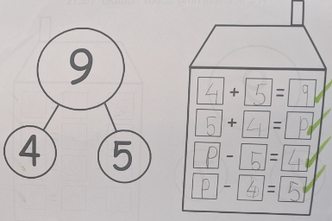
Addition/ Subtraction- Fact Families
Children understanding that numbers are related through addition and subtraction.
Knowing that addition is commutative (the numbers can swap around and you will get the same answer)
Subtraction- the biggest number always goes at the start
There are no surprises! All the numbers are there for them to use.

Slide 12

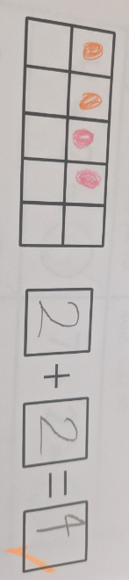
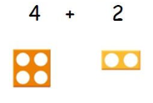

Addition- Early Level
Adding up to 10
Conceptual understanding of addition- understanding you will get a bigger number, knowing final number you touch is your total
In P1, they need to grasp that that putting two amounts together, creates a total, the numbers go up the number line- the numbers get bigger.
Concrete Materials (cubes- ‘there’s 4 cubes!, can you count them and check for me?’
It’s helpful if children are secure in subitising
Using ten frames and numicon really support subitising whilst addition and support speed in recognising the answers
Numicon- how numbers fit together- knowing the colours supports with quick addition
Cuisenaire Rods
Draw it!
Part- Part Whole

Slide 13
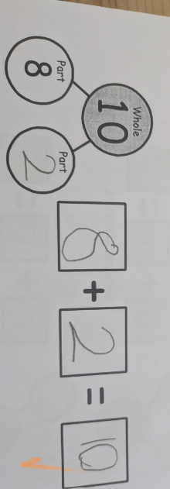
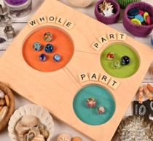
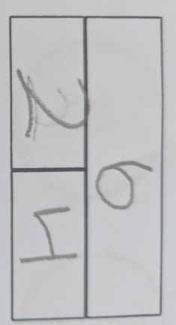
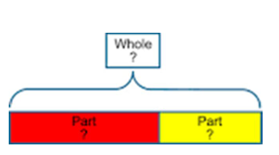
Addition-
Part- Part Whole
Breaking numbers in two parts
This is abstract- it is important learner does this with concrete materials/ drawings first
Alastair is going to show you how this might be used in first and second level

Slide 14

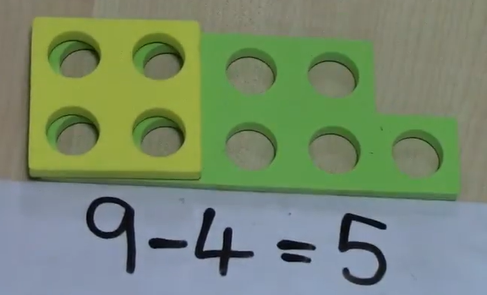
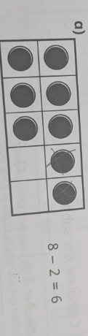
Subtraction- Early Level
Children typically find this trickier as it is counting back
They need to understand that it is not commutative
They need to understand the importance of zero
Early level subtraction looks similar to addition
Use of ten frames
Number lines and jumping back
Numicon – smaller number placed on top
Cuisenaire Rods
Concrete materials- understanding the total number is going to be less

Slide 15
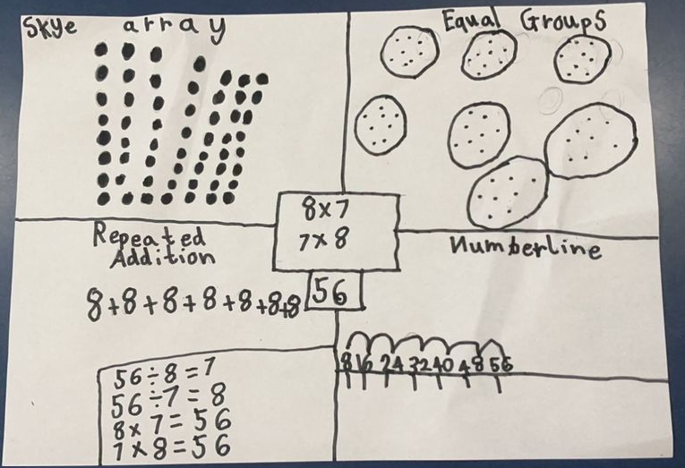
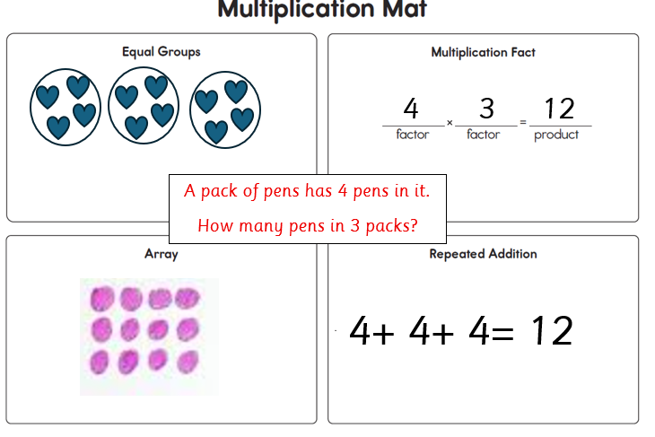
Think Boards
Think Boards allow children to work out their number problems in four different ways or choose a strategy that they prefer
think boards suitable for all 4 operations
They can have a sum/ word problem to solve in the middle

Slide 16
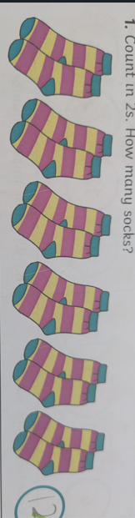

Multiplication- Early Level
Multiplication is not explicitly taught at this stage
Skip counting is introduced- counting in 2s, 5’s and 10’s- lots of verbal practise
Counting in groups of 2/ 5s/ 10s with concrete materials
Adding numicon together (repeated addition)
Cuisenaire Rods on a number track

Slide 17

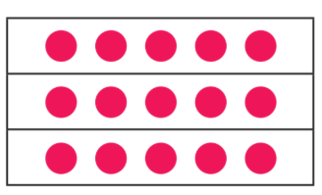
Multiplication- Arrays
A matrix of dots
Dots need to be in straight lines so that it is clear and easy to count
Dots can be counted individually or skip counted
Numicon Board
2x 10 = 20
3x 5 = 15

Slide 18
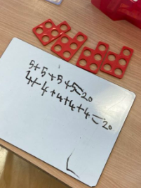
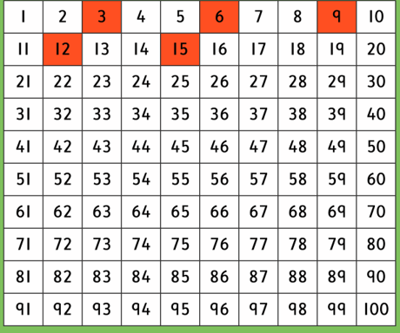
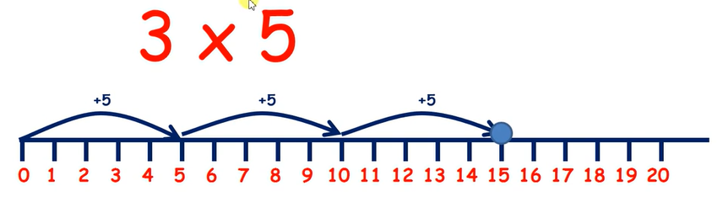
Multiplication- repeated addition
Skip counting
Using Numicon
Using an empty number line/ Cuisenaire rods
Using a hundred square
3x 5= 15

Slide 19
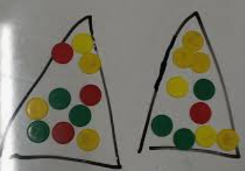
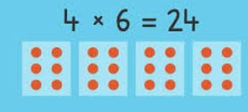

Multiplication- Equal Groups
Can be drawn or loose parts used
2x 10 = 20
2x 5 = 10

Slide 20
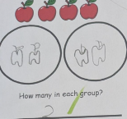
Division- Early Level
Sharing into equal groups using concrete materials
Not yet using ÷, but good to recognise this
Visuals really help at this stage- encouraging
One at a time and every group having the same
No remainder

Slide 21
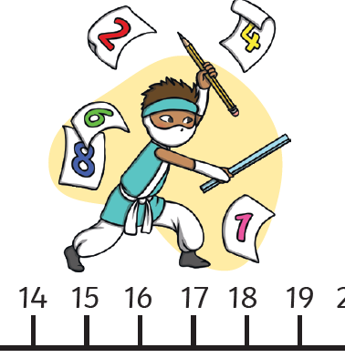
Division- repeated subtraction
Empty Number line and counting backwards
Using a hundred square to support if needed
How many jumps did you need to get to zero?

Slide 22
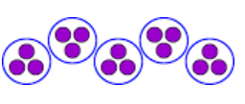
Division- Equal Groups
Look at the divisor- create groups
Share the dividend equally between each group
You can use materials or pens and paper for this

Slide 23
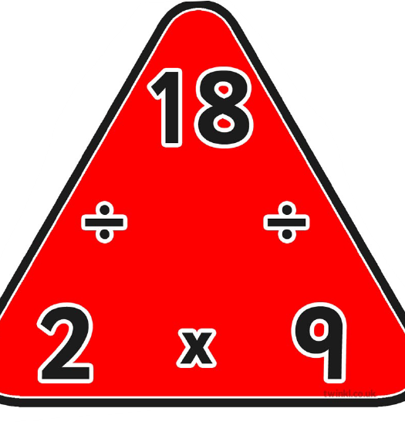
Multiplication and Division Fact Families
Multiplication and Division are usually taught together
It is important children see that they are linked together- multiplication is the inverse of division
The triangles are a visual representation of this

Slide 24

Counting on
Use of fingers- this is okay!
This is a great tool when the numbers are not too far apart
Small number in head and count on… for subtraction and addition
Use of number line
Alastair will share what this looks likes for upper school further on (using an empty number line)

Slide 25
Using a Number line
Filled number lines in P1 and P2, moving onto a 100 square in p3
Important children know the direction that numbers go
Allows children to keep track of multi- step problems
We will use a blank number line to demonstrate numeracy strategies as we progress through the presentation

Slide 26
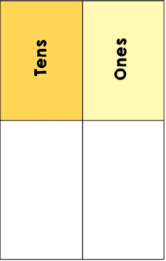
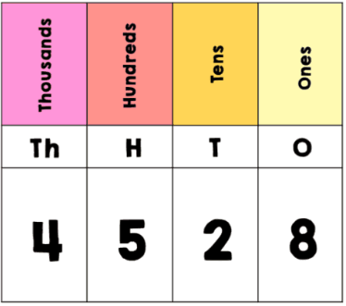
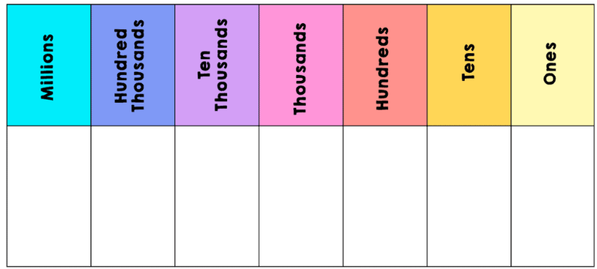
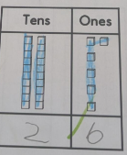
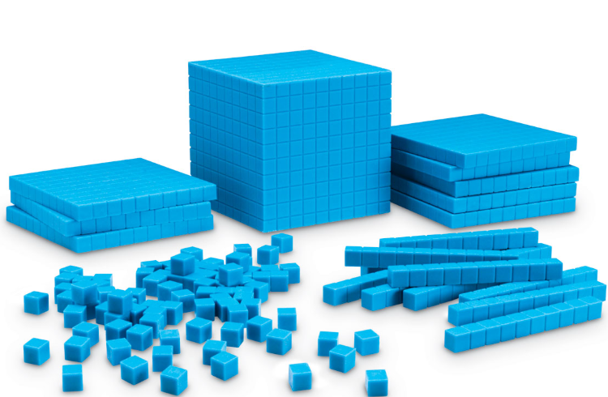
Partitioning
Base Ten- seeing what it looks like first
Polypad
Early Level- Beginning to explore tens and ones
1st level- partitioning numbers into hundreds, tens and ones
2nd level- partitioning numbers into millions, thousands, hundred, tens

Slide 27
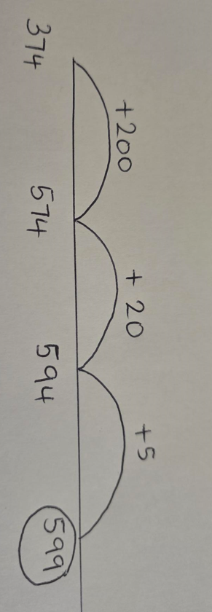
Partitioning (addition example)
374 + 225
Pupils can of course partition both numbers
300 + 200=500
70 + 20 = 90
4 + 5 = 9
500 + 90 + 9 = 599

Slide 28
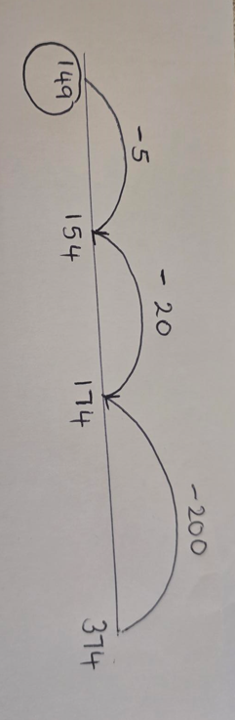
Partitioning (subtraction example)
374-225

Slide 29
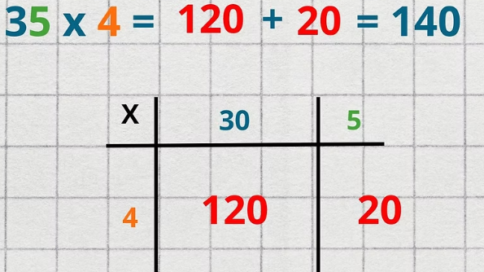
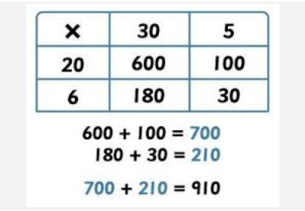
Multiplication- Grid Method (Partitioning)
Importance of understanding multiplying by 10 and 100

Slide 30
Compensation (Friendly Numbers)
Friendly Numbers- numbers that are easier to work with
In p2 and P3 this might look like 99 +99 which is similar to 100+ 100…
Compensation- rounding to the nearest 10 or 100 and adding or subtracting to compensate

Slide 31
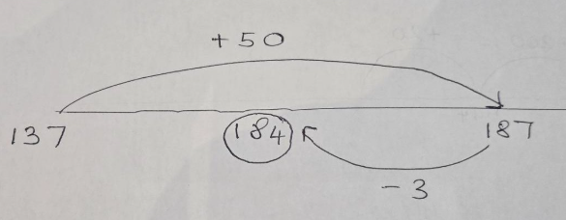
Compensation (Addition)
137 + 47
47 is rounded up to 50

Slide 32
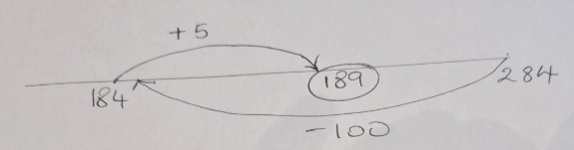
Compensation (Subtraction)
284 – 95
95 is rounded up to 100

Slide 33
Compensation (multiplication)
24 X 9 (Round the 9 to 10)
H T O
2 4
2 4 0 (x10)
240 – 19 = 221

Slide 34
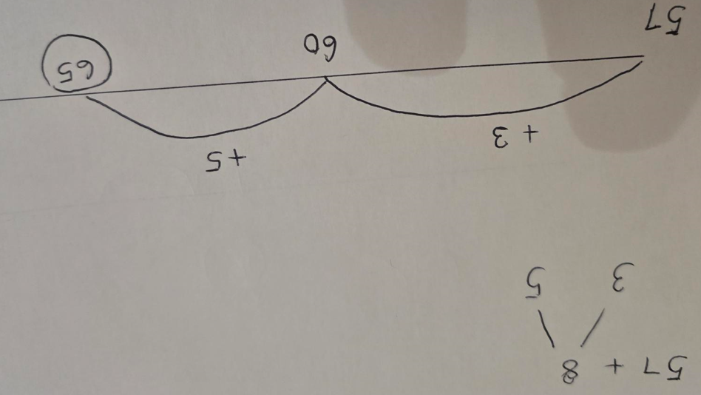
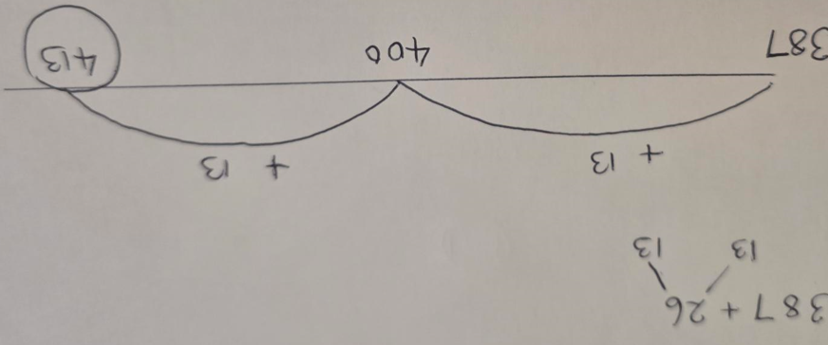
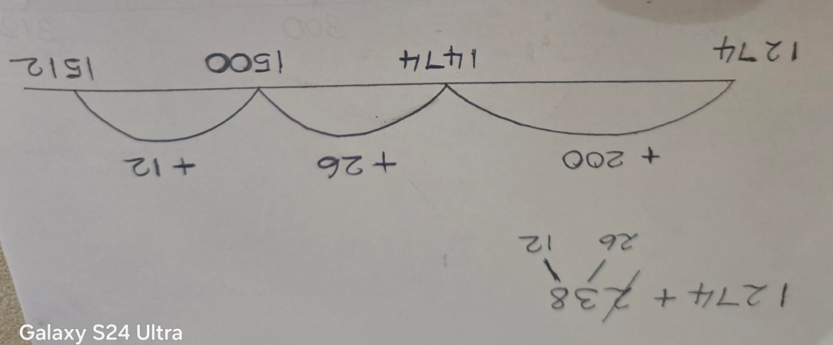
Splitting- Addition

Slide 35
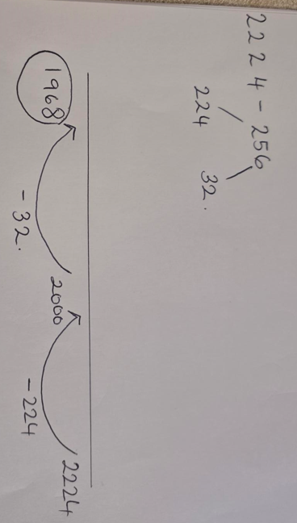
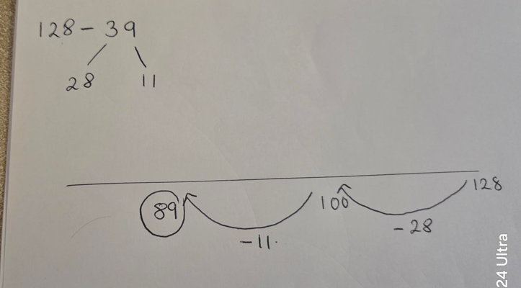
Splitting- Subtraction

Slide 36



Addition- Formal written method
P4 P5 P6

Slide 37



Subtraction- Formal Written Methods
P5 P5 P6

Slide 38


Multiplication- Formal Method
P5/6 P6

Slide 39


Formal Method - Division
P5 P7

Slide 40

Positive Numeracy Environment at Home
Positive attitude towards maths and numeracy
Mistakes are learning opportunities- supporting them to find the right answer (Praising process over product)
Embedded in everyday routines- cooking, baking, counting, shopping, time management, solving problems together
Games- board games, building materials, mental maths agility games (Buzz, 3,6,9, skip counting)
Number Bonds/ Multiplication Facts- conceptual understanding comes first.
Using the same language and strategies at home as in school
Writing materials always available

Slide 41
Materials/ Experiences that help at home
Writing Materials- allows children to make visual representations
Loose Parts- Lego, beads, buttons, pencils, spoons, stickers etc
Egg timer/ Stopwatch- to develop speed with mental maths- set them a challenge!
Money- including children in sticking to budgets/ creating totals/ calculating change
Number Line
Dice
deck of playing cards
Online Games (Sumdog- used widely in school)
Games- Board Games/ Verbal games

Slide 42

Darts
Can be used as one of the ‘at home experiences’
Numbers 1-20
X 2 and X 3 tables (doubles & trebles)
Addition to 180 (3 darts totals)
Subtraction (501*)
* Can change to 101, 301, 1001 etc

Slide 43

Darts – In the classroom
For addition and subtraction

Slide 44

Darts in the classroom
For multiplication and addition

Slide 45

Darts in the classroom
For addition, multiplication and subtraction

Slide 46

Time to Explore and Ask Questions!
Benchmarks
Visual Aids
Concrete Materials and how they are used
Think Boards
Useful Websites
Video QRs of the strategies explained
Games you can play at home
Questions welcome!

